Slide 1
Virtualization

Slide 2
Objectives
Define virtualization
List components of virtualization

Slide 3
Virtualization
Environment that imitates real hardware
OS cannot distinguish from real thing
Imitates the actual host hardware
Special software virtualizes the environment
Host is the real hardware and OS
Guest is the virtual machine

Slide 4
Supervisor
Controls interaction between hardware and OS
Allocation of RAM
CPU time…
Allows one OS to deal with hardware

Slide 5
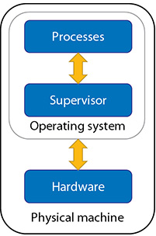
Supervisor

Slide 6
Hypervisor
Acts as supervisor to guest OS
Handles the numerous requests from guests
Talks directly to the hardware

Slide 7
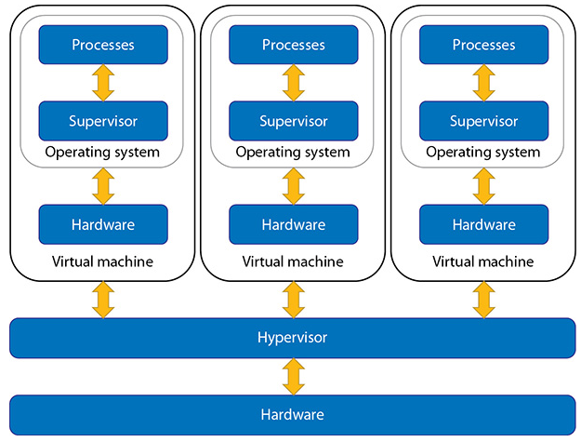
Hypervisor

Slide 8
Hypervisor types
Two main types
Difference is the existence of host OS

Slide 9
Hypervisor Type 1
AKA Bare Metal Hypervisors
No host OS installed
Virtual Product installed on server
Faster VM experience
Requires dedicated VM servers

Slide 10
Hypervisor Type 1
Products
Citrix XenServer
VMWare ESXi
Oracle VMServer
Microsoft Hyper-V

Slide 11
Hypervisor Type 2
Requires a host OS installed
Slower VM experience
Non dedicated server
Can handle both VM and normal server roles

Slide 12
Hypervisor Type 2
Products
VMWare Workstation
Oracle VirtualBox
Apple Parallels
QEMU

Slide 13
Virtualization Benefits
Power saving
Fewer actual servers
Faster deployment
Security
Snapshotting
Research

Slide 14
Hardware Virtualization Support
Computers since 2005 support hypervisors
Both Intel and AMD have added support in CPU
Must enable in BIOS
Intel VT-X
AMD-V

Slide 15
Installing a guest OS
Turn on the BIOS virtualization support
Install a hypervisor product
Create a new guest
Allocate RAM for guest and host
Leave enough RAM for host to run
Allocate lots of disk space
Install the OS within the VM environment

Slide 16
Disk Space Thin Provisioning
The disk storage needs grow as the OS grows
Only used storage is allocated to the VM
Ex - allocate 50GB to Win 10
Only 11 GB is needed for install
VMware allocates 11GB to VM

Slide 17
Disk Space Thick Provisioning
All requested storage is allocated to VM
Ex - allocate 50GB to Win 10
Only 11 GB is needed for install
VMWare allocates 50GB for the VM

Slide 18
Hardware Emulation in VM
Certain hardware devices are emulated
NIC, sound, video
Simplifies the coding for hypervisor
Hypervisor converts the VM card to real card
Requires guest software installed
VM Tools….

Slide 19
Virtual Networking
Virtual computers can be part of networks
Often servers are virtualized to save space
Three main types
Internal
Bridged
Switches

Slide 20
Internal Networking
Guest OS can only see other guest OS
Creates a secure network environment
Use for testing or paranoid network admins

Slide 21
Bridged Networking
Virtual card connects to actual card
Allows VM to interact with real network
Bridges the divide from internal to real

Slide 22
Switched Networking
A virtual switch is built
Allows both internal and bridged networking

Slide 23
Emulation
Hardware pretends it is something else
Ex: Nintendo Emulator on a Intel computer
Software completely acts like the hardware

